Slide 1

Chapter 31
Network Security
31.<number>
Copyright © The McGraw-Hill Companies, Inc. Permission required for reproduction or display.

Slide 2
31-1 SECURITY SERVICES
Network security can provide five services. Four of these services are related to the message exchanged using the network. The fifth service provides entity authentication or identification.
Topics discussed in this section:
Message Confidentiality
Message Integrity
Message Authentication
Message Nonrepudiation
Entity Authentication
31.<number>

Slide 3
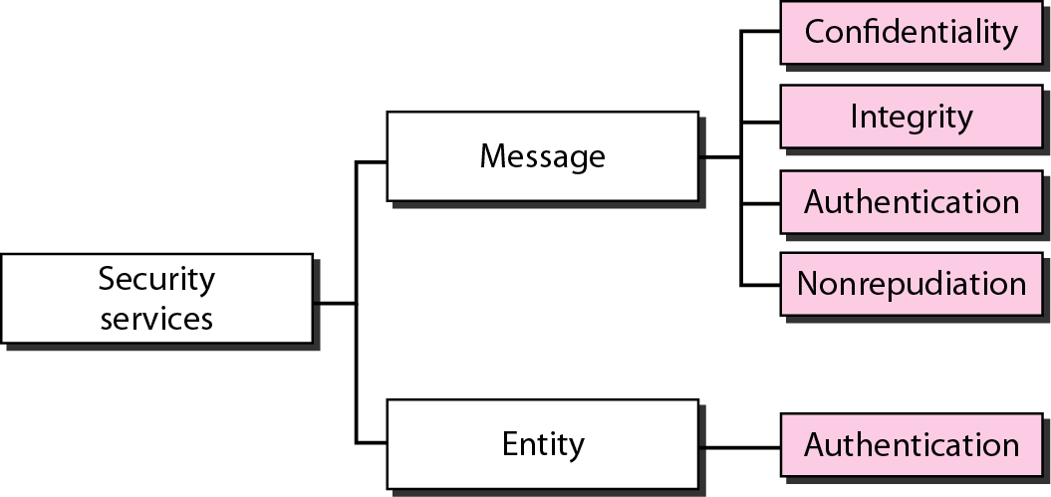
Figure 31.1 Security services related to the message or entity
31.<number>

Slide 4
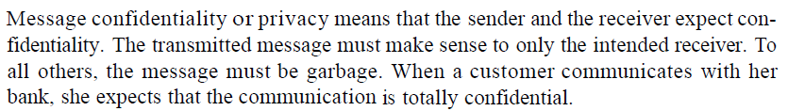
31-2 MESSAGE CONFIDENTIALITY
The concept of how to achieve message confidentiality or privacy has not changed for thousands of years. The message must be encrypted at the sender site and decrypted at the receiver site. This can be done using either symmetric-key cryptography or asymmetric-key cryptography.
Topics discussed in this section:
Confidentiality with Symmetric-Key Cryptography
Confidentiality with Asymmetric-Key Cryptography
31.<number>

Slide 5
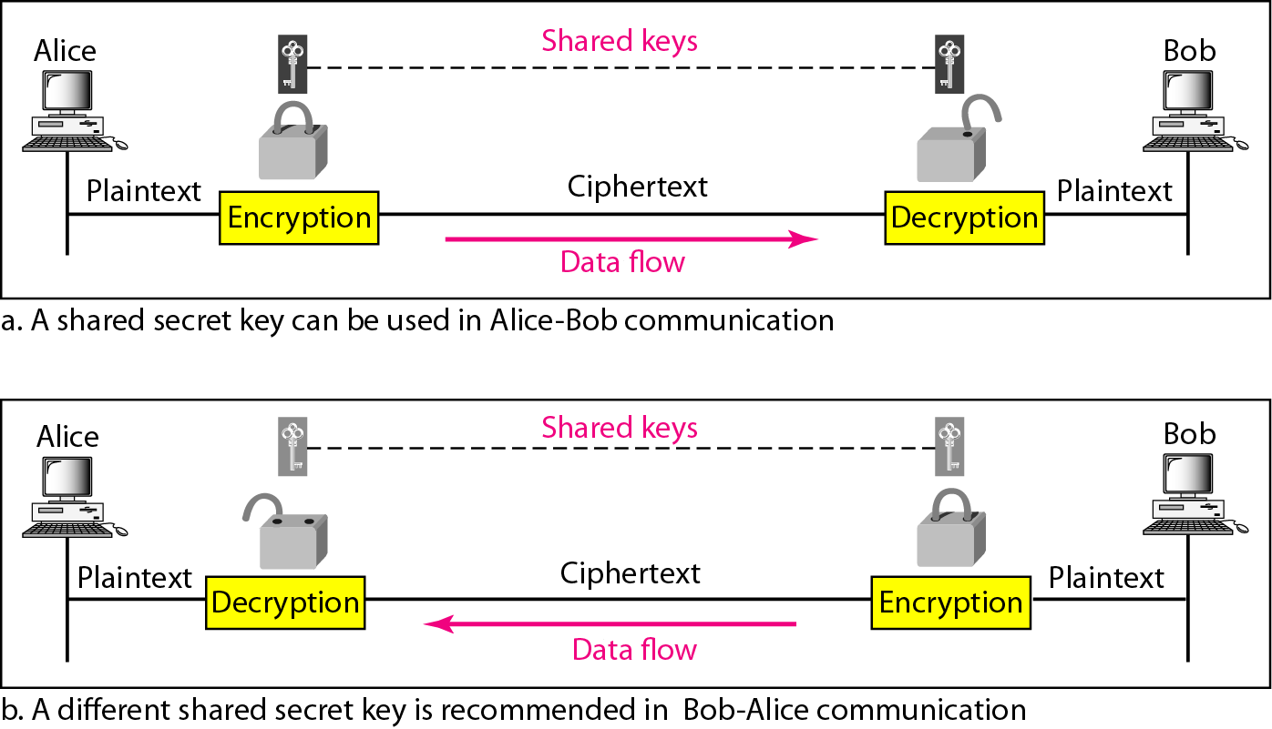
Figure 31.2 Message confidentiality using symmetric keys in two directions
31.<number>

Slide 6
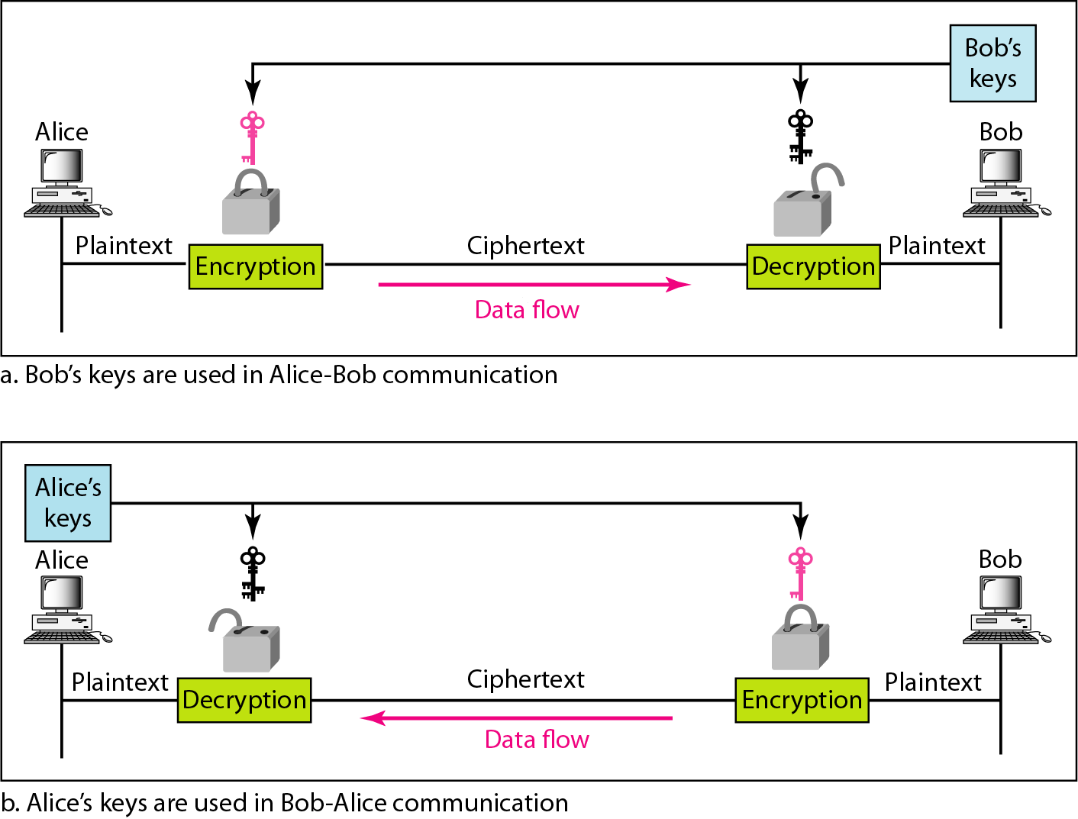
Figure 31.3 Message confidentiality using asymmetric keys
31.<number>

Slide 7
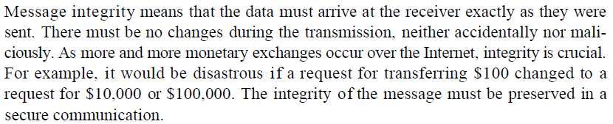
31-3 MESSAGE INTEGRITY
Encryption and decryption provide secrecy, or confidentiality, but not integrity. However, on occasion we may not even need secrecy, but instead must have integrity.
Topics discussed in this section:
Document and Fingerprint
Message and Message Digest
Creating and Checking the Digest
Hash Function Criteria
Hash Algorithms: SHA-1
31.<number>

Slide 8

Note
To preserve the integrity of a document,
both the document and the fingerprint are needed.
31.<number>

Slide 9
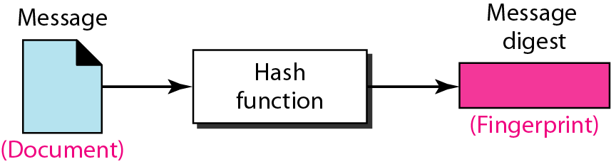
Figure 31.4 Message and message digest
31.<number>

Slide 10
Note
The message digest needs to be kept secret.
31.<number>

Slide 11
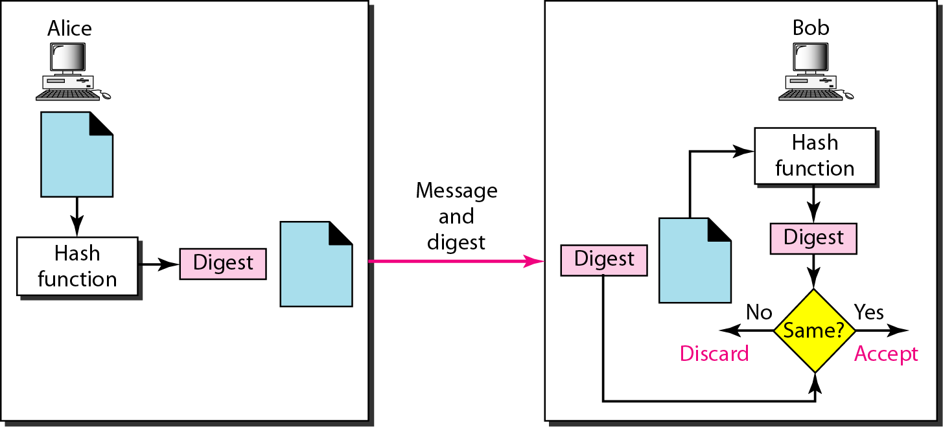
Figure 31.5 Checking integrity
31.<number>

Slide 12
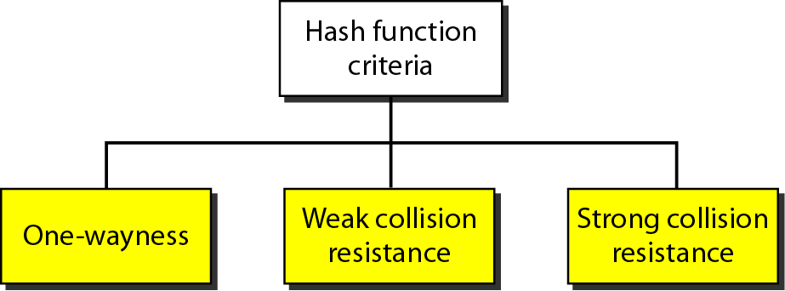
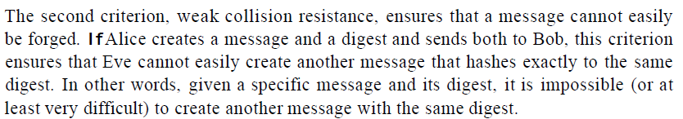
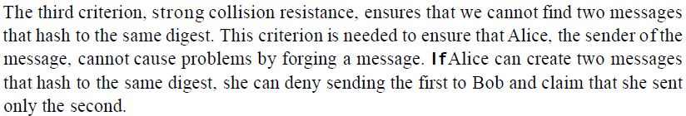
Figure 31.6
Criteria of a hash function
31.<number>

Slide 13
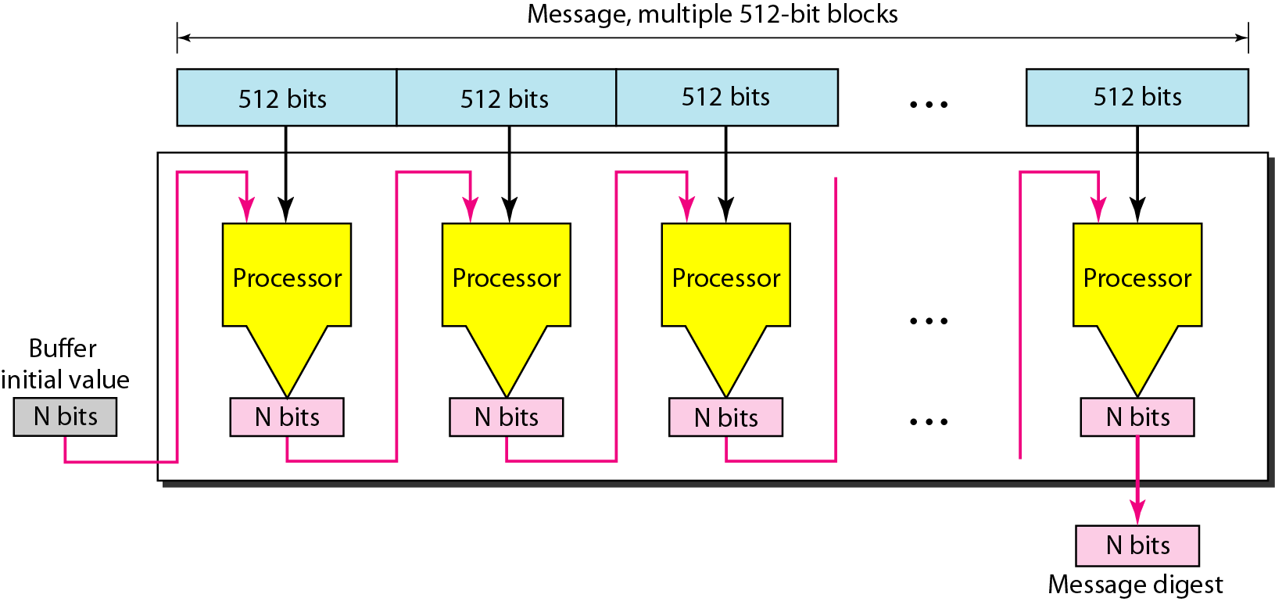
Figure 31.7 Message digest creation
31.<number>

Slide 14
Note
SHA-1 hash algorithms create an N-bit message digest out of a message of
512-bit blocks.
SHA-1 has a message digest of 160 bits (5 words of 32 bits).
31.<number>

Slide 15
31-4 MESSAGE AUTHENTICATION
A hash function guarantees the integrity of a message but cannot authenticate the sender of the message. The digest created by a hash function can detect any modification in the message, but not authentication. The digest created by hash function is called modification detection code (MDC).
Topics discussed in this section:
Message Authentication Code (MAC).
31.<number>

Slide 16
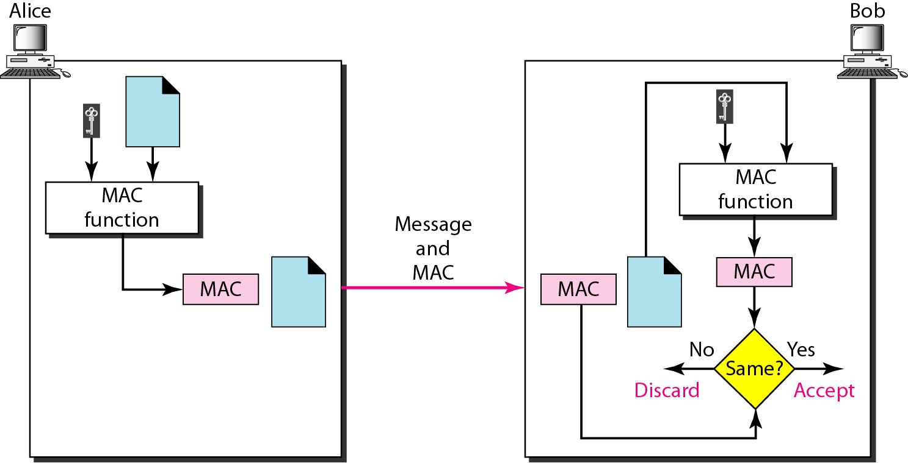
Figure 31.9 MAC, created by Alice and checked by Bob
MAC: - To provide message authentication, we need to change modification detection code to message authentication code (MAC). MDC uses keyless hash function, MAC uses keyed hash function. Keyed hash function uses symmetric key between sender and receiver when creating a digest.
31.<number>

Slide 17
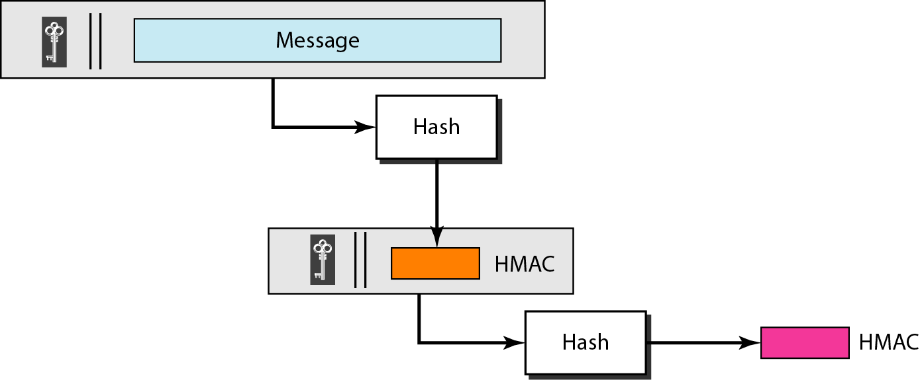
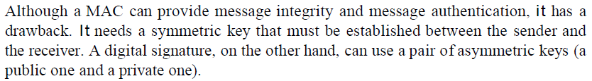
Figure 31.10 HMAC (Hashed Message Authentication Code)
31.<number>

Slide 18
31-5 DIGITAL SIGNATURE
When Alice sends a message to Bob, Bob needs to check the authenticity of the sender; he needs to be sure that the message comes from Alice and not Eve. Bob can ask Alice to sign the message electronically. In other words, an electronic signature can prove the authenticity of Alice as the sender of the message. We refer to this type of signature as a digital signature.
Topics discussed in this section:
Comparison
Need for Keys
Process
Services
31.<number>

Slide 19
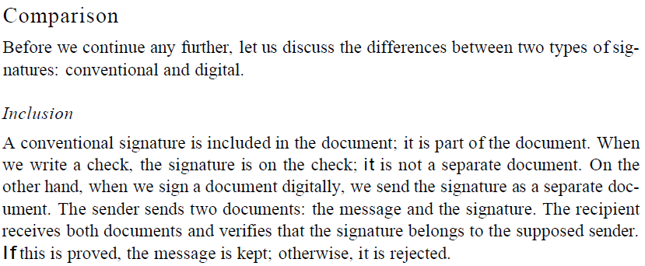
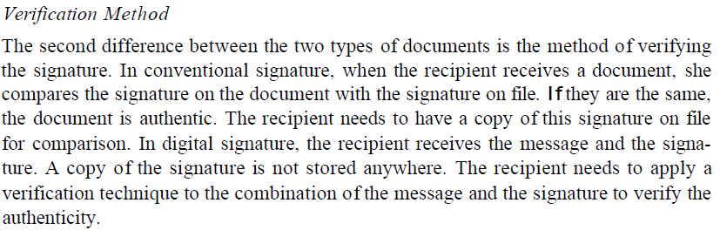
31.<number>

Slide 20
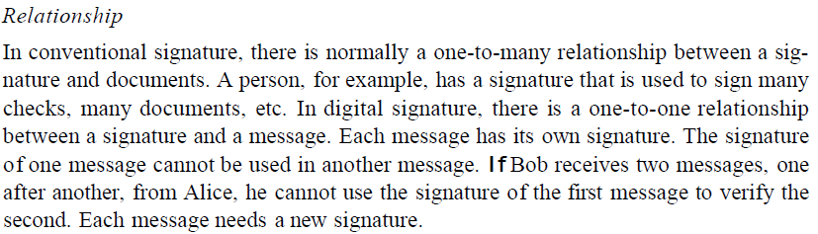
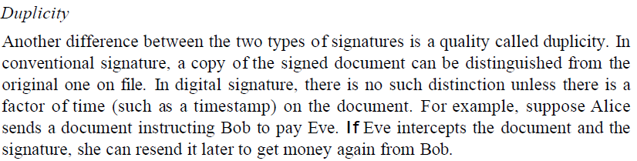
31.<number>

Slide 21
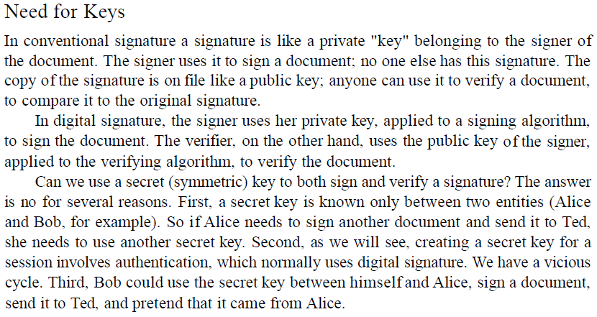
A digital signature needs a public-key system.
31.<number>

Slide 22
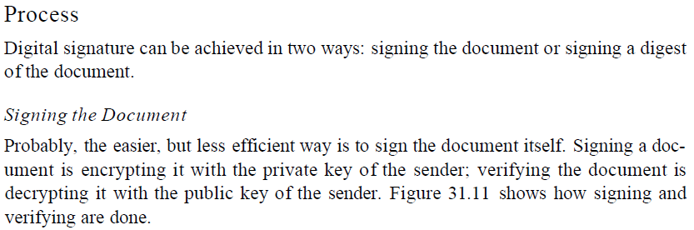
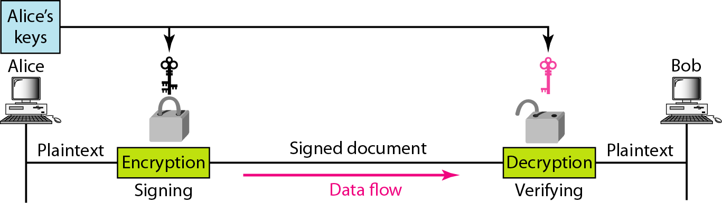
Figure 31.11 Signing the message itself in digital signature
31.<number>

Slide 23
Note
In a cryptosystem, we use the private and public keys of the receiver;
in digital signature, we use the private and public keys of the sender.
31.<number>

Slide 24
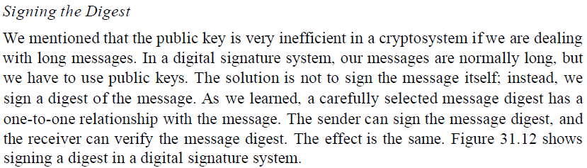
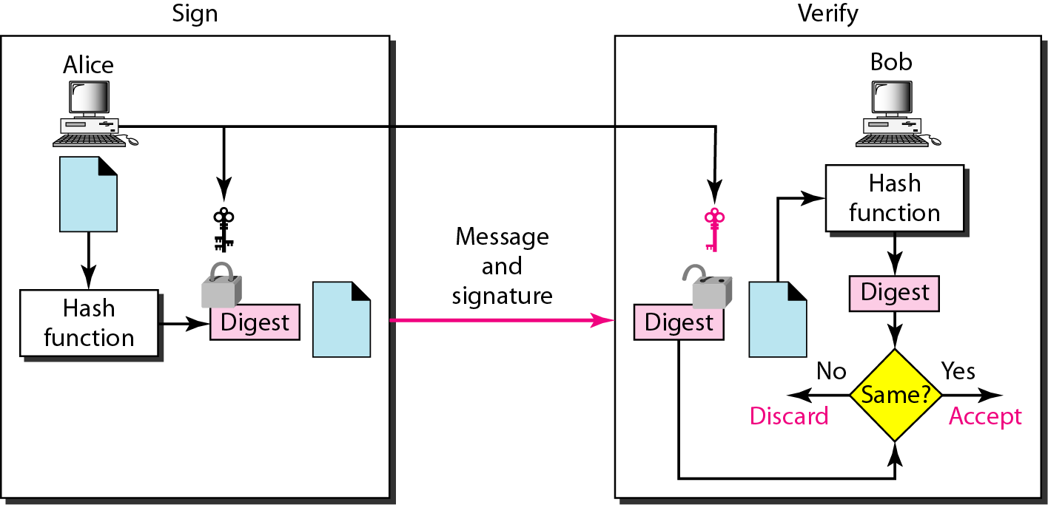
Figure 31.12 Signing the digest in a digital signature
31.<number>

Slide 25
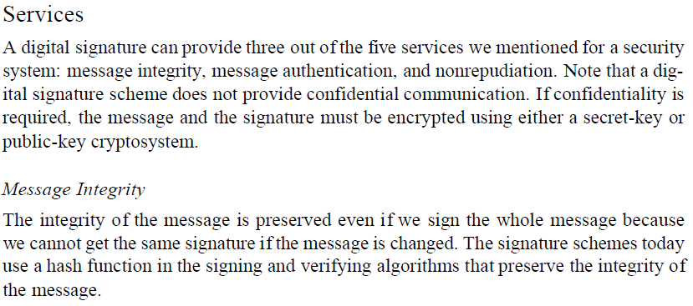
A digital signature today provides message integrity.
31.<number>

Slide 26
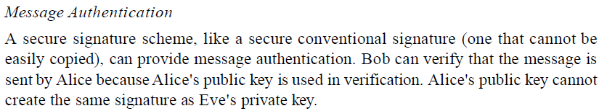
Digital signature provides message authentication.
31.<number>

Slide 27
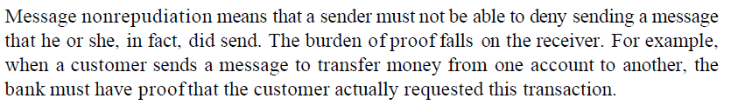
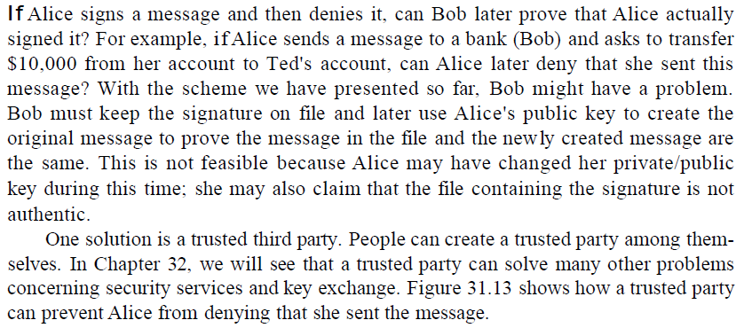
MESSAGE NONREPUDIATION
31.<number>

Slide 28
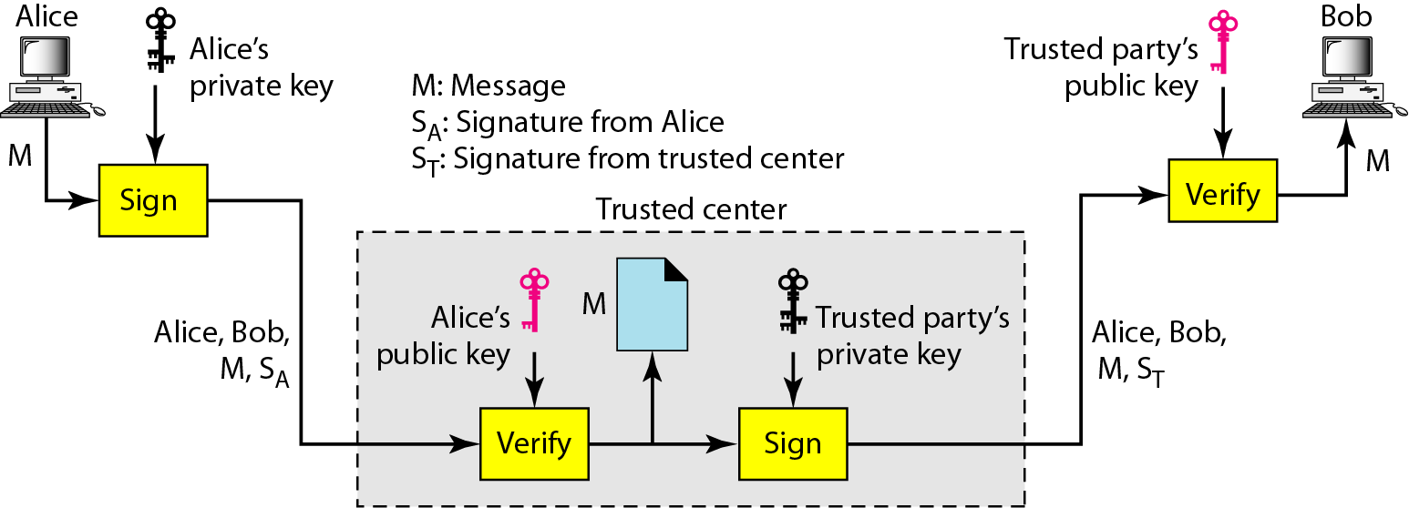
Figure 31.13 Using a trusted center for nonrepudiation
Nonrepudiation can be provided using a trusted party.
31.<number>

Slide 29
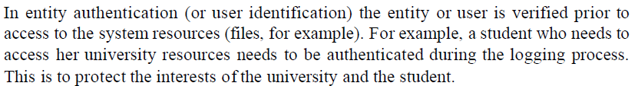
31-6 ENTITY AUTHENTICATION
Entity authentication is a technique designed to let one party prove the identity of another party. An entity can be a person, a process, a client, or a server. The entity whose identity needs to be proved is called the claimant; the party that tries to prove the identity of the claimant is called the verifier.
Topics discussed in this section:
Passwords
Challenge-Response
31.<number>

Slide 30
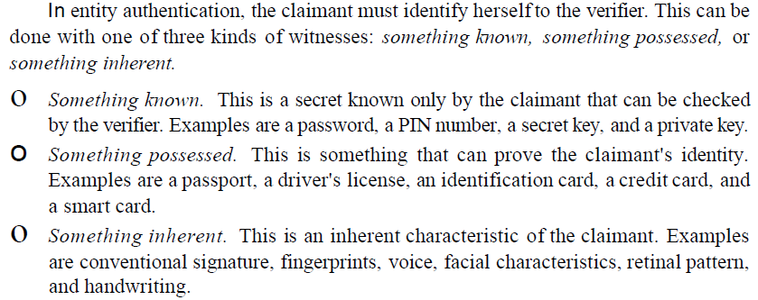
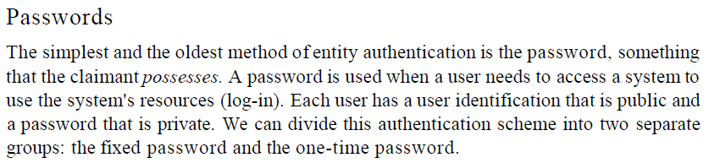
31.<number>

Slide 31
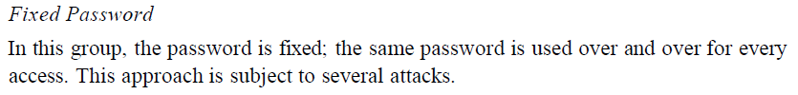
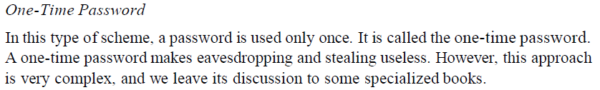
Eavesdropping
Stealing a Password
Accessing a file
Guessing
31.<number>

Slide 32
In challenge-response authentication,
the claimant proves that she knows a secret without revealing it.
The challenge is a time-varying value sent by the verifier;
the response is the result of a function applied on the challenge.
31.<number>

Slide 33
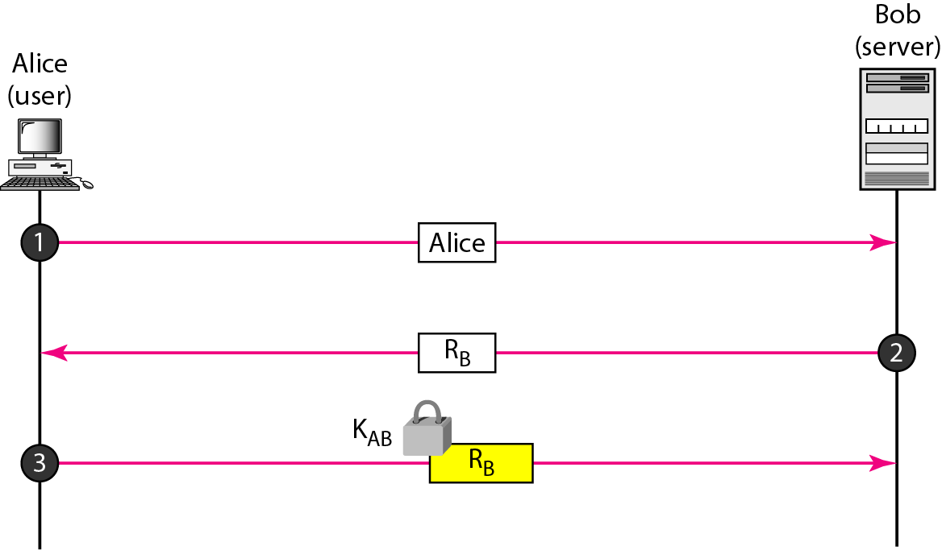
Figure 31.14 Challenge/response authentication using a nonce
31.<number>

Slide 34
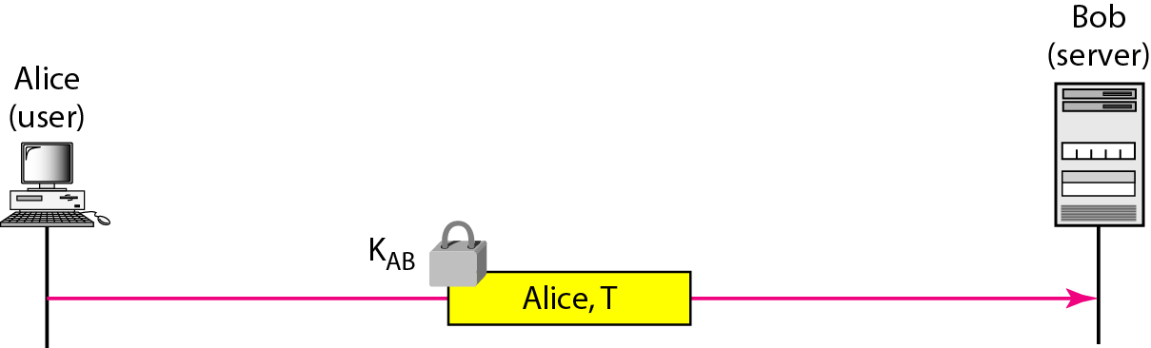
Figure 31.15 Challenge-response authentication using a timestamp
31.<number>

Slide 35
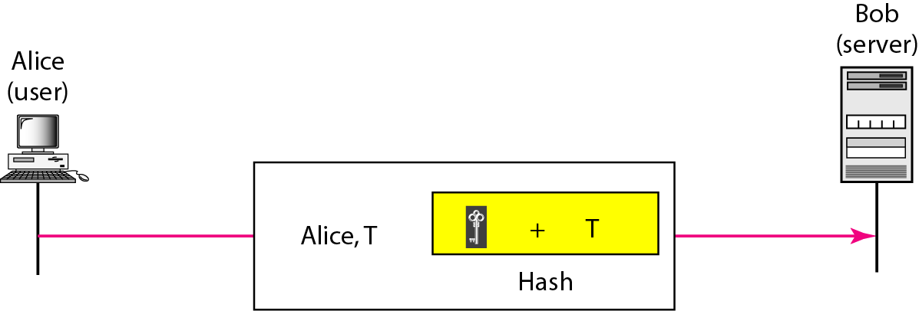
Figure 31.16 Challenge-response authentication using a keyed-hash function
31.<number>

Slide 36
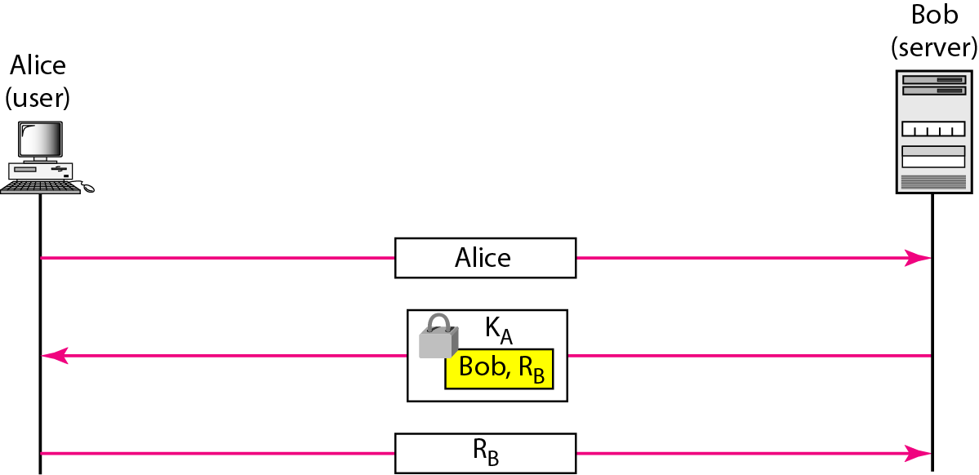
Figure 31.17 Authentication, asymmetric-key
31.<number>

Slide 37
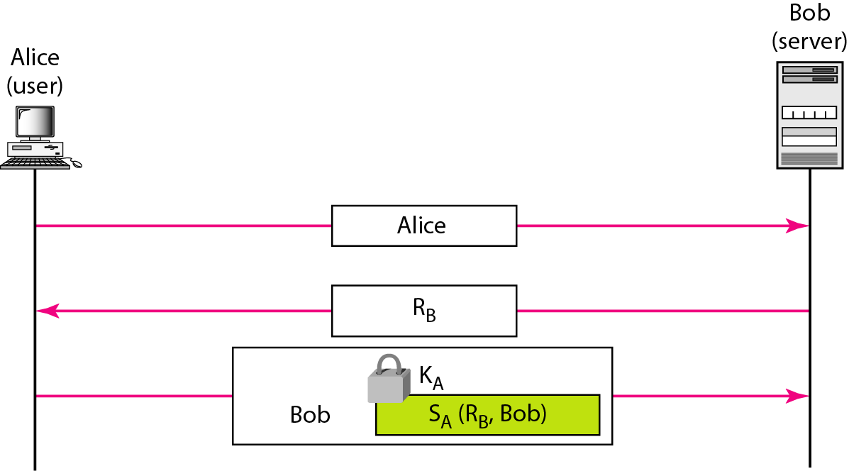
Figure 31.18 Authentication, using digital signature
31.<number>

Slide 38
31-7 KEY MANAGEMENT
We never discussed how secret keys in symmetric-key cryptography and how public keys in asymmetric-key cryptography are distributed and maintained. In this section, we touch on these two issues. We first discuss the distribution of symmetric keys; we then discuss the distribution of asymmetric keys.
Topics discussed in this section:
Symmetric-Key Distribution
Public-Key Distribution
31.<number>

Slide 39
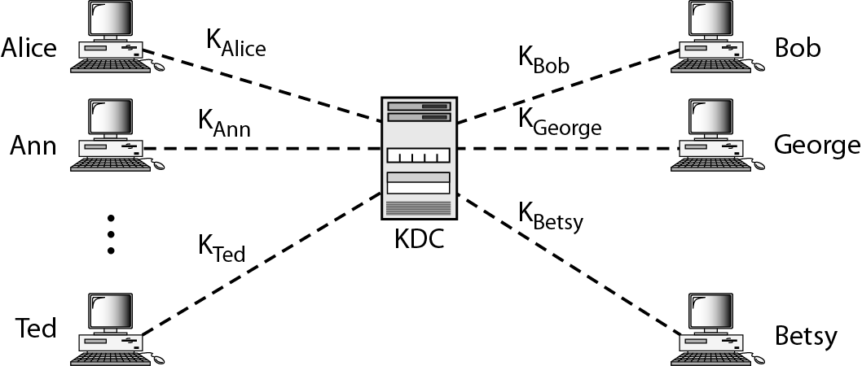
Figure 31.19 KDC
31.<number>

Slide 40
Note
A session symmetric key between two parties is used only once.
31.<number>

Slide 41
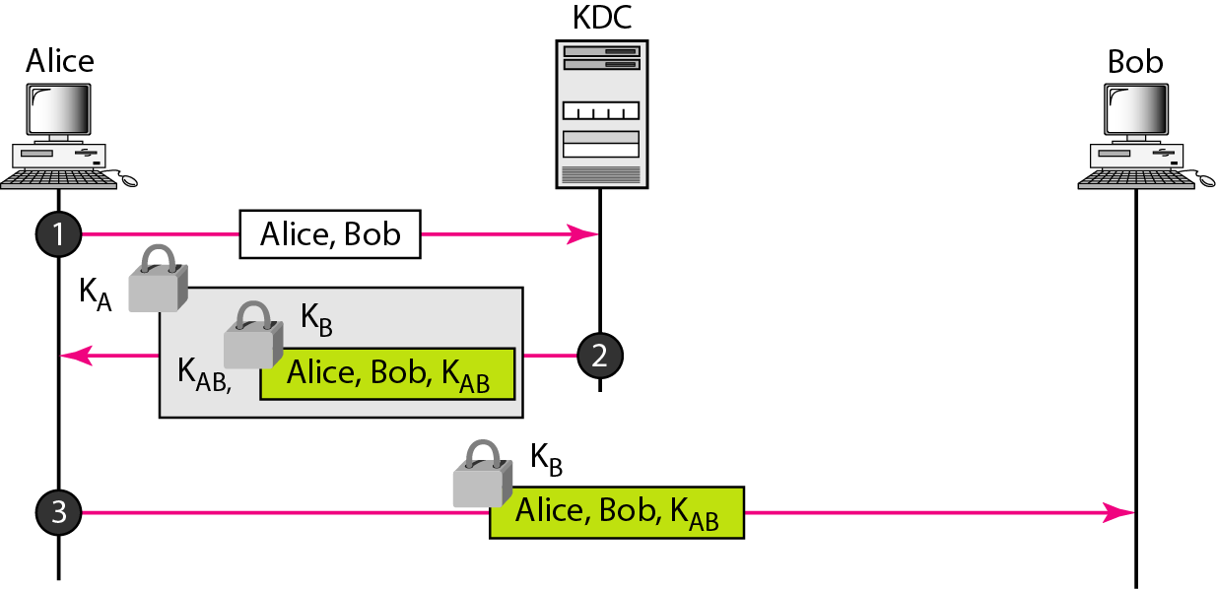
Figure 31.30 Creating a session key between Alice and Bob using KDC
31.<number>

Slide 42
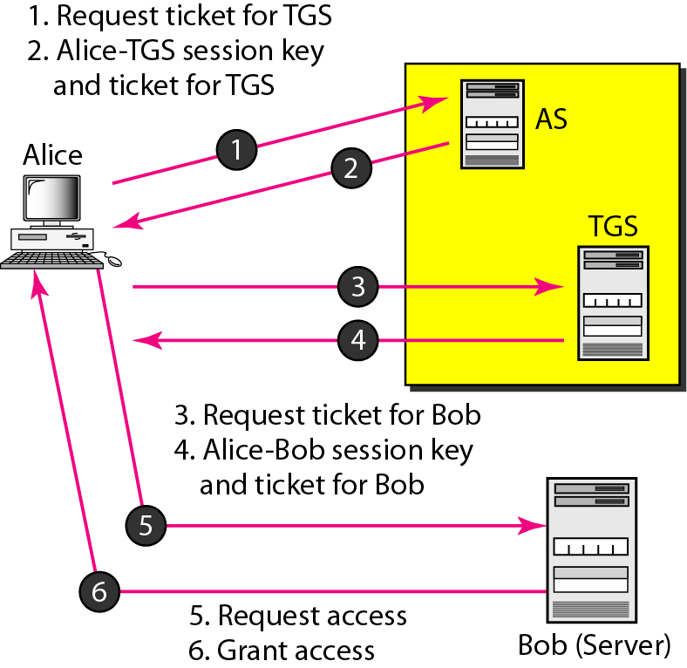
Figure 31.21 Kerberos servers
31.<number>

Slide 43
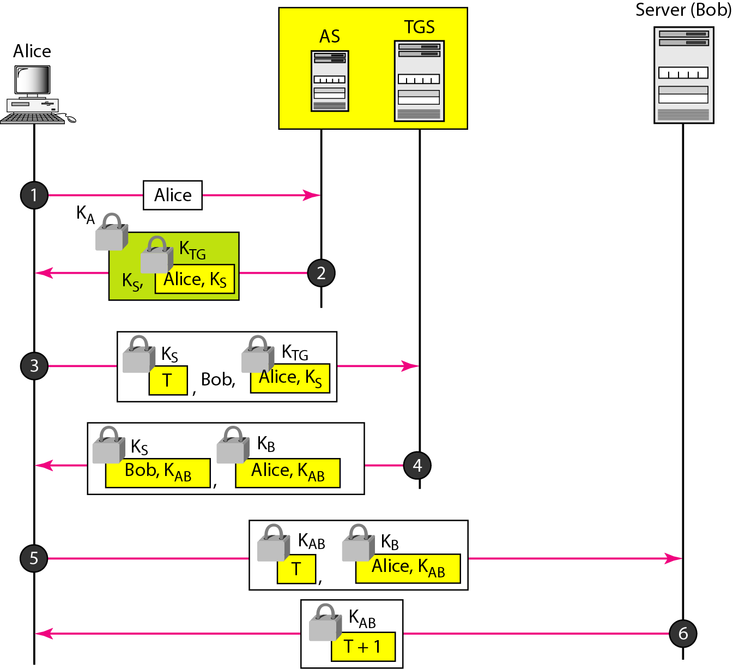
Figure 31.22 Kerberos example
31.<number>

Slide 44
Note
In public-key cryptography, everyone has access to everyone’s public key;
public keys are available to the public.
31.<number>

Slide 45
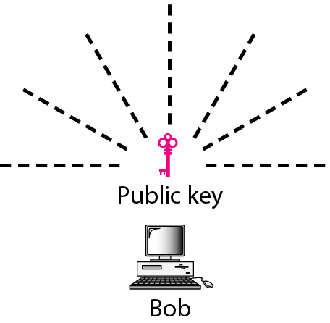
Figure 31.23 Announcing a public key
31.<number>

Slide 46
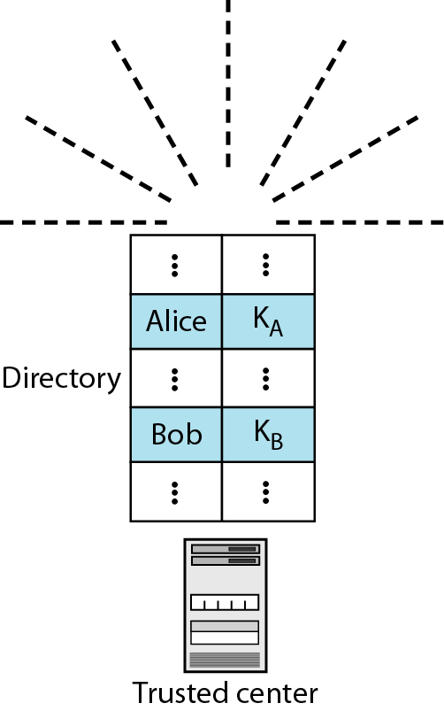
Figure 31.24 Trusted center
31.<number>

Slide 47
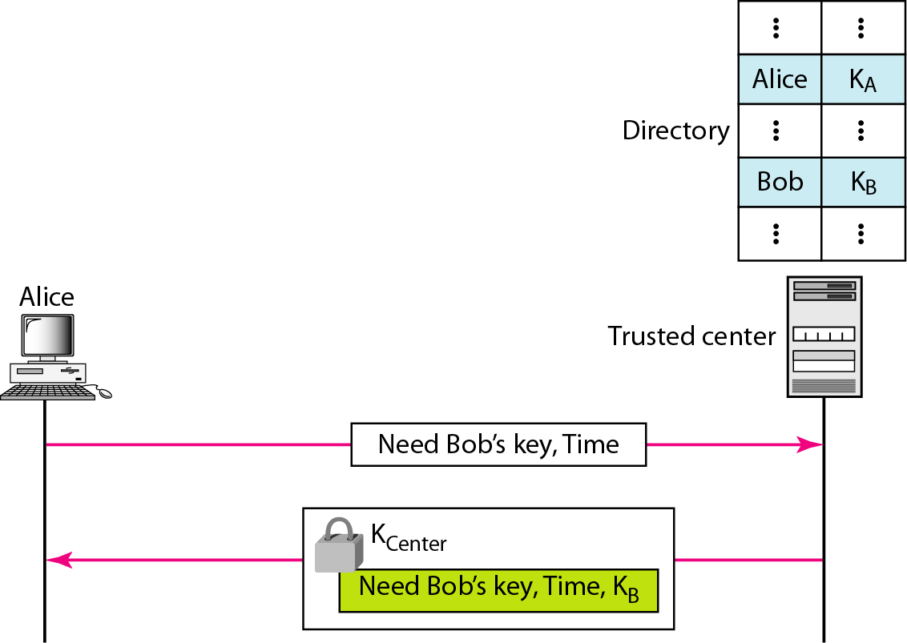
Figure 31.25 Controlled trusted center
31.<number>

Slide 48
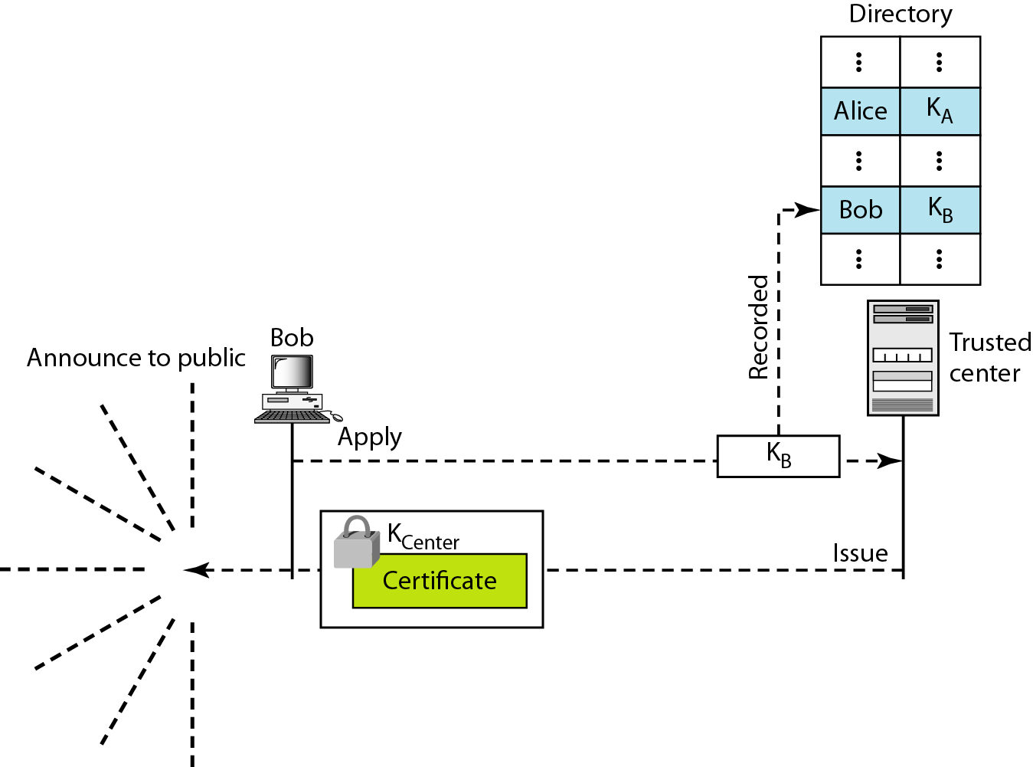
Figure 31.26 Certification authority
31.<number>

Slide 49
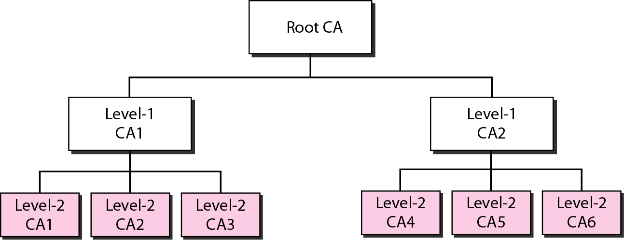
Figure 31.27 PKI hierarchy
31.<number>

